Slide 1
DEEP LEARNING PROJECT Adversarial Attack and Defense on Traffic Sign Classifier
TONGLI ZHU
QINGYI XU
Tinsae A. Yehuala
Shixun Liu

Slide 2
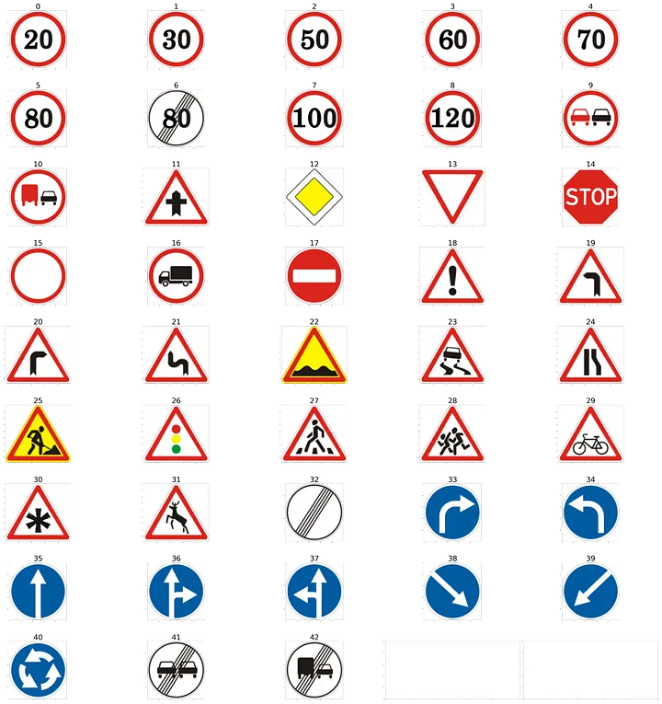
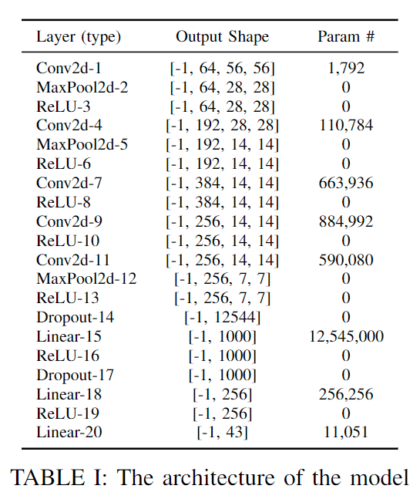
overview
Data Set:
German Traffic Sign Recognition Benchmark (GTSRB)
Model:
AlexNet Variant
Attack Methods:
Fast Gradient Sign Method (FGSM),
Projected Gradient Descent (PGD)
Defense Strategy:
Adversarial Training with FGSM and PGD Examples
Regularization Techniques: L2 Regularization, Dropout
Evaluation:
Loss
Accuracy
1. Smaller 3x3 convolution kernel
2. Last fully connected layer - 43 categories

Slide 3
Attack and defense implementation flow

Slide 4
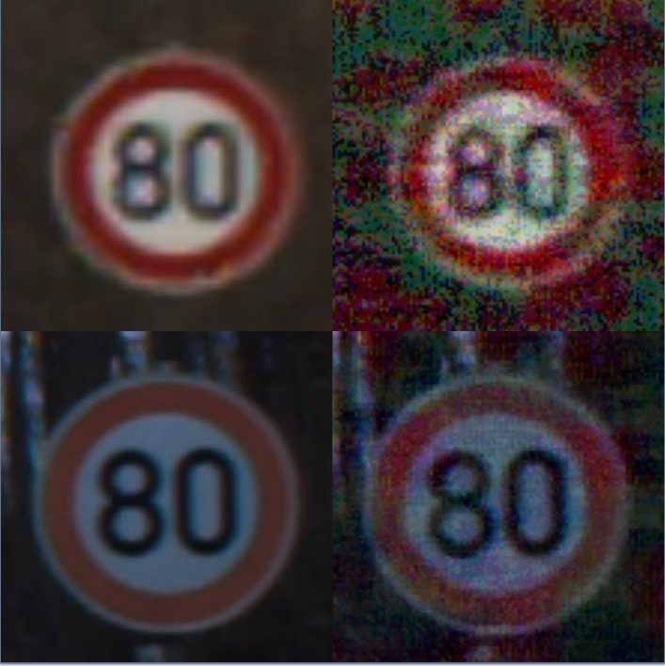
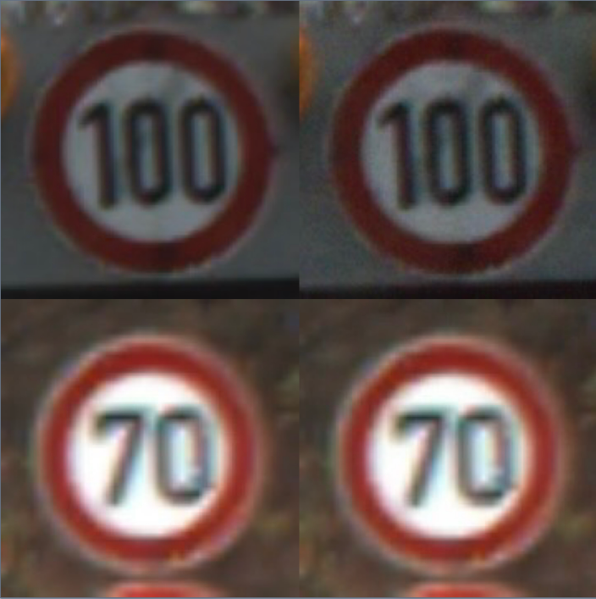
Result - Attack
ε = 0.12:
Original samples (left)
Samples attacked (right) by FGSM (up)
Samples attacked (right) by PGD (down)
ε = 0.015:
Original samples (left)
Samples attacked (right) by FGSM (up)
Samples attacked (right) by PGD (down)

Slide 5
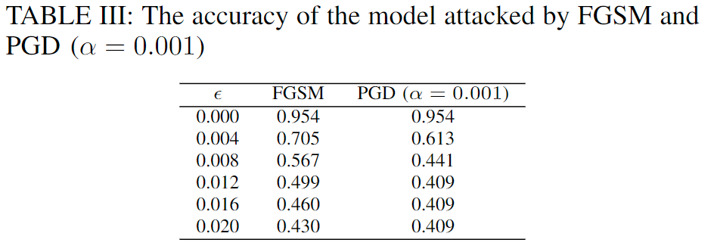
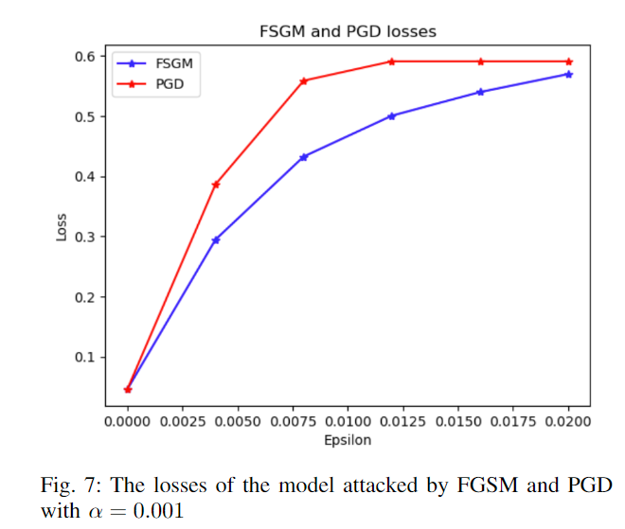
Result - Attack

Slide 6
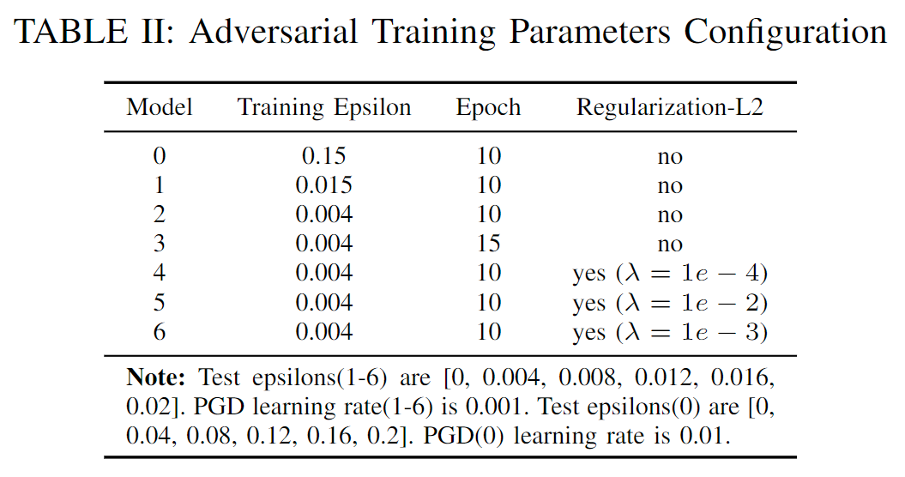
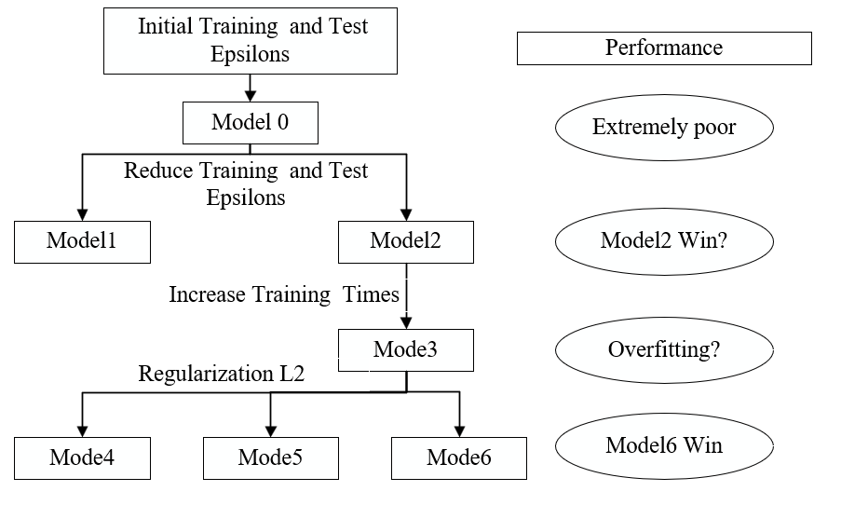
defense experiment configuration

Slide 7
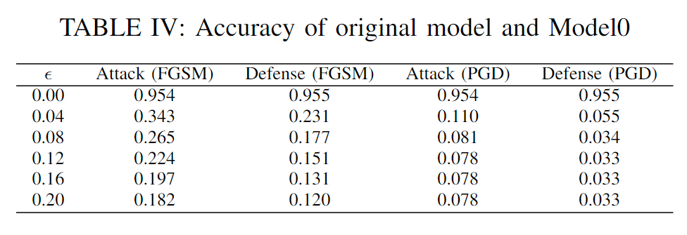
Result - Defense
Initial Experiment
using ε = 0.15 and α = 0.1 as parameters for generating adversarial sample

Slide 8
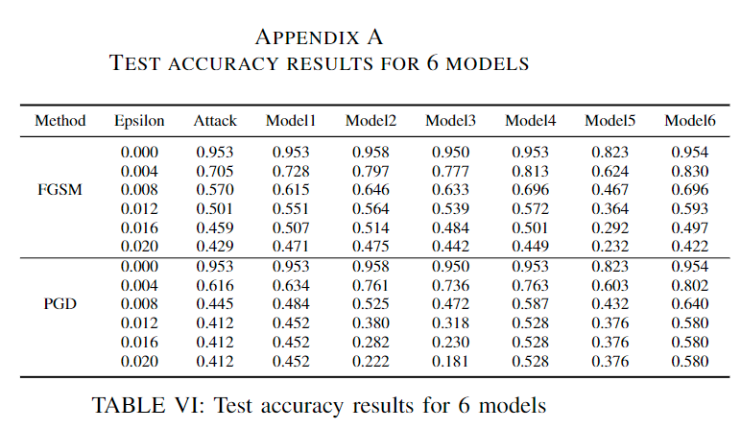
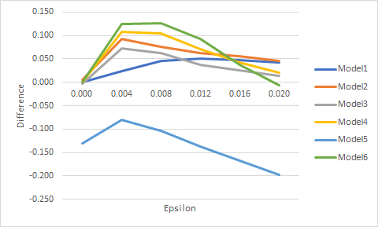
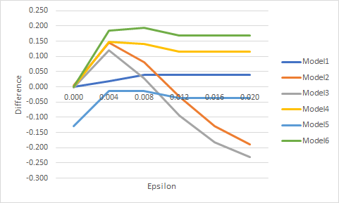
Result - Defense
Improved Experiments
FGSM
PGD

Slide 9
Conclusion
What we learn through this course and project
How to setup Deep learning training environment.(GPU)
How to test a pre-trained model.
How to modify the model and train the new model.
What methods we can take to change the model’s generalization.
The knowledge about the FGSM, PGD, and Regulation——from theory to practice.
What we can improve if we continue this work
Adversarial sample diversification: using different epsilons to train
Adding additional regularizations: early stopping, and continuously optimize the parameters of the L2 regularization
Trying more advanced methods(model): C&W Attack (Carlini & Wagner Attack), GANs for Defense (Generative Adversarial Networks.

Slide 10
Thank you
TONGLI ZHU
QINGYI XU
Tinsae A. Yehuala
Shixun Liu

